Slide 1

FOOT BALL
BY
SUSHIL VARMA – YEAR 3A
VALLEY INTERNATIONAL SCHOOL

Slide 2
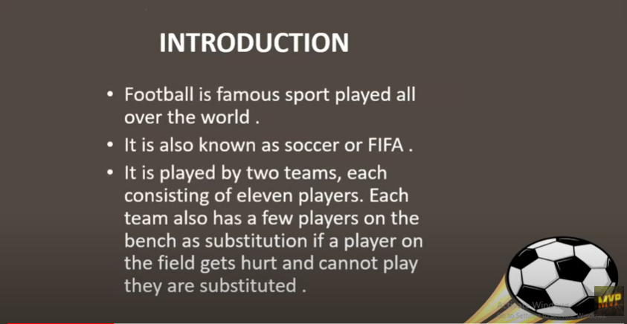

Slide 3
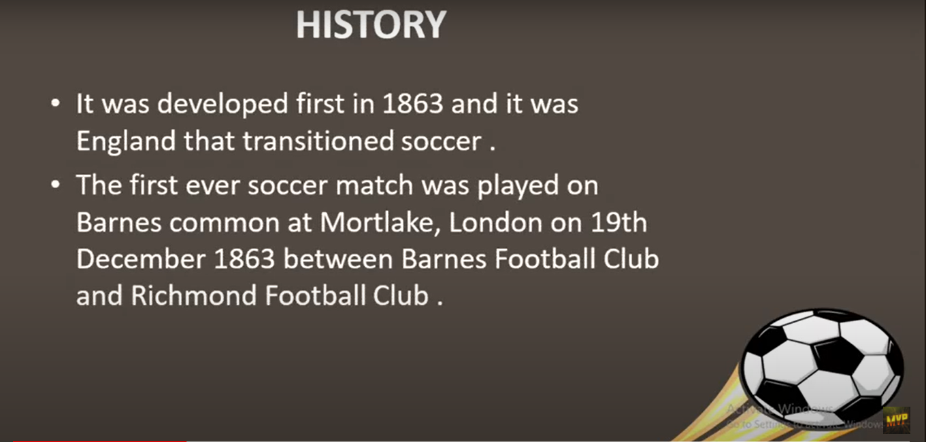

Slide 4
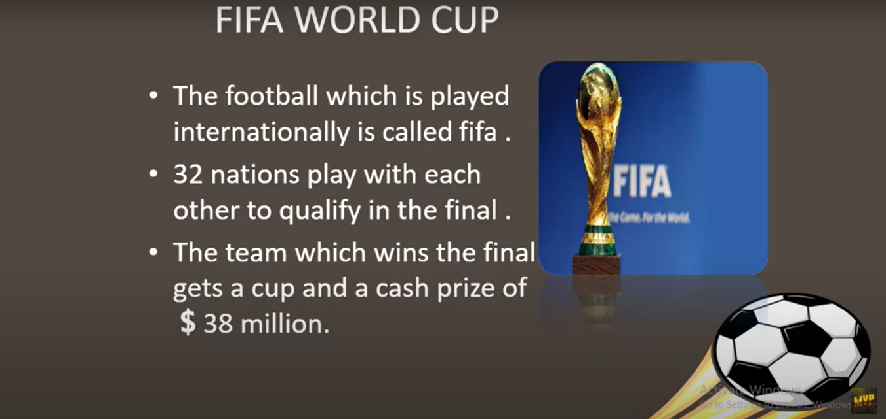

Slide 5

KEY TERMS
1.Back of the net
2.Ball-to-hand
3. Bicycle kick
4. Box-to-box player
5. Brace
6. Chip shot
7. Class act
8. Clean sheet
9. Clinical finish
10. Cracker
11. Dive
12. Flick-on

Slide 6
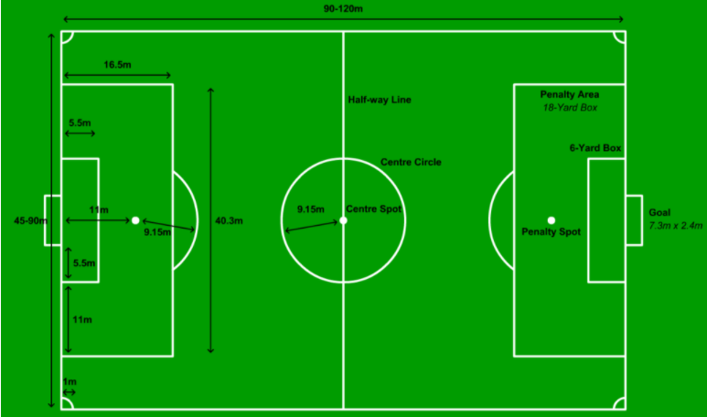
Dimensions of the Foot Ball Court

Slide 7
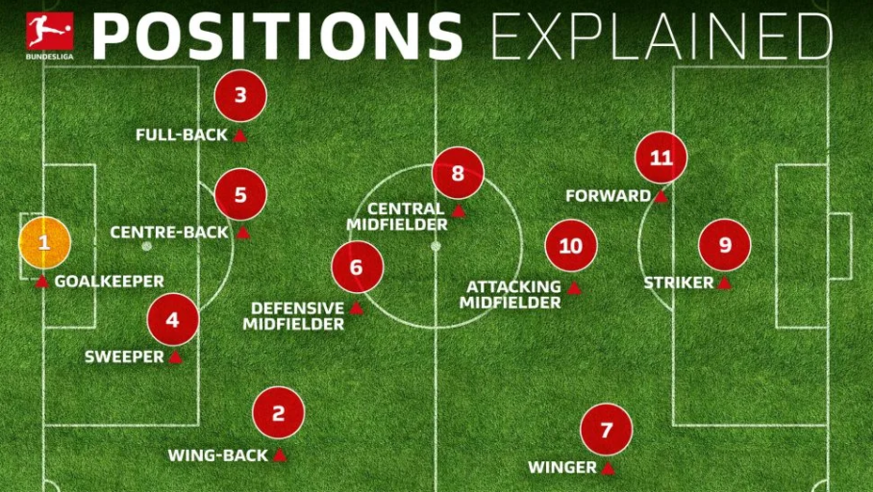

Slide 8


Slide 9
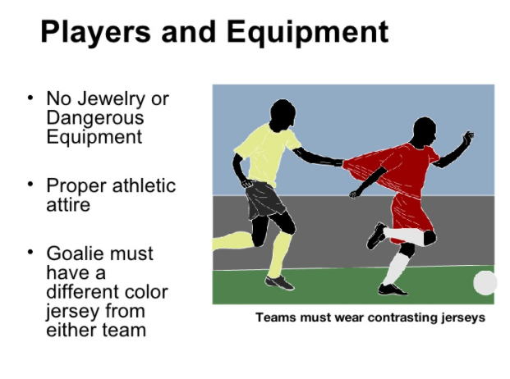

Slide 10


Slide 11
Thank You

